Slide 1
2
___________________________________
Memory Hierarchy Design
Source: Book1, Book5

Slide 2
Source1: Book1 (CH#2)
Source2: Book 5 (CH#4): Computer Organization and Architecture, Designing for Performance by William Stallings (Chapter Uploaded on SLATE).

Slide 3
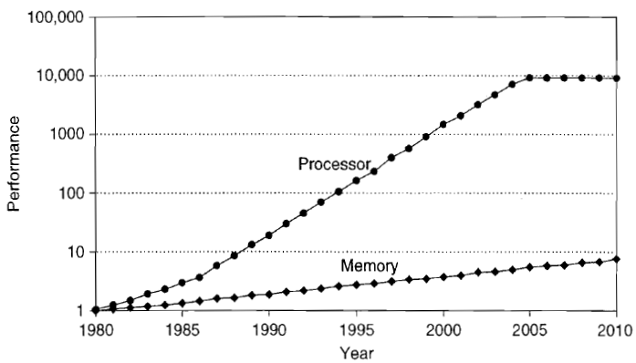
Processor-Memory Performance Gap

Slide 4
2.1 Introduction
The principle of locality: most programs do not access all code or data uniformly.
This principle, plus the guideline that for a given implementation technology and power budget smaller hardware can be made faster, led to hierarchies based on memories of different speeds and sizes.
Since fast memory is expensive, a memory hierarchy is organized into several levels—each smaller, faster, and more expensive per byte than the next lower level, which is farther from the processor.

Slide 5
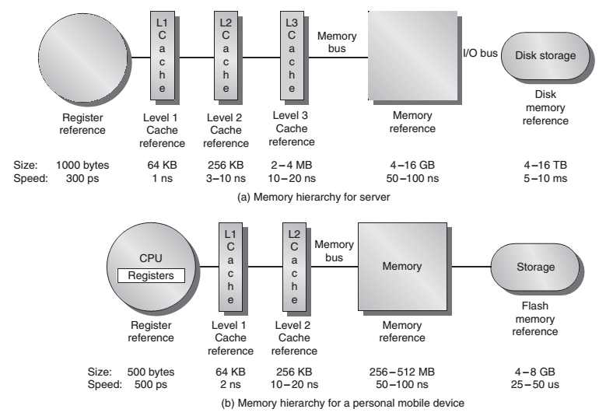

Slide 6
Caches
A CPU cache is a hardware cache used by the central processing unit (CPU) of a computer to reduce the average cost (time or energy) to access data from the main memory.
A cache is a smaller, faster memory, closer to a processor core, which stores copies of the data from frequently used main memory locations.
Most CPUs have different independent caches, including instruction and data caches, where the data cache is usually organized as a hierarchy of more cache levels (L1, L2, etc.).
https://en.wikipedia.org/wiki/CPU_cache

Slide 7
Primary Cache Vs Secondary Cache
Cache memory is an extremely fast memory type that acts as a buffer between RAM and the CPU.
It holds frequently requested data and instructions so that they are immediately available to the CPU when needed.
Cache memory is located in two general locations: inside the processor (internal cache) and on the motherboard (external cache):
Internal cache: also known as primary cache, internal cache is located inside the CPU chip.
External cache: also known as secondary cache, external cache is located on the motherboard outside the CPU. This is the cache referred to on PC specifications.
https://www.sqa.org.uk/e-learning/HardOSSupp01CD/page_19.htm

Slide 8
L1, L2, L3 Caches
Level 1 (L1) cache: L1 cache is placed internally on the processor chip and is, of course, the cache memory closest to the CPU.
Level 2 (L2) cache: L2 cache, on older systems, is normally placed on the motherboard close to the CPU. Manufacturers today have both L1 and L2 cache installed on the CPU.
Level 3 (L3) cache: L3 cache on new systems relates to the cache on the motherboard.
https://www.sqa.org.uk/e-learning/HardOSSupp01CD/page_19.htm

Slide 9
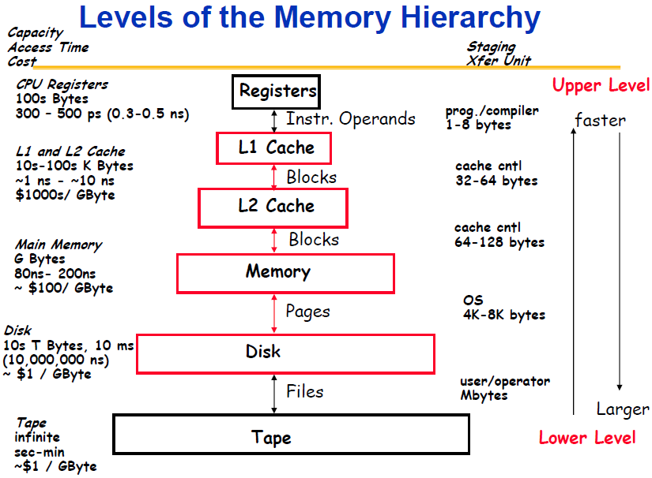
http://rickvanderzwet.nl/trac/personal/browser/liacs/ca/slides/lecture01.pdf?rev=3

Slide 10
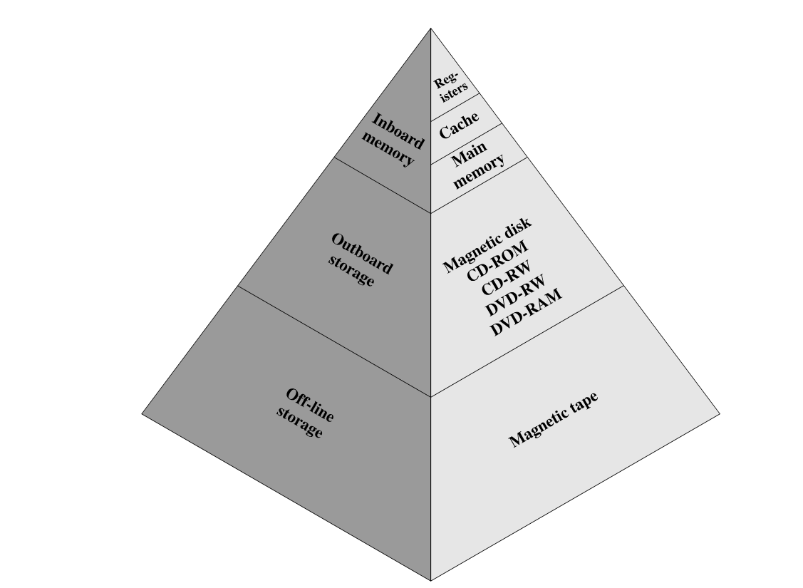

Slide 11

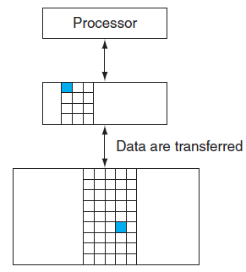


Data Transfer b/w Two Adjacent Levels

Slide 12
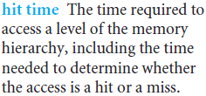
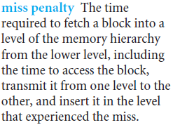
Hit Time and Miss Penalty
Since performance is the major reason for having a memory hierarchy, the time to service hits and misses is important.

Slide 13
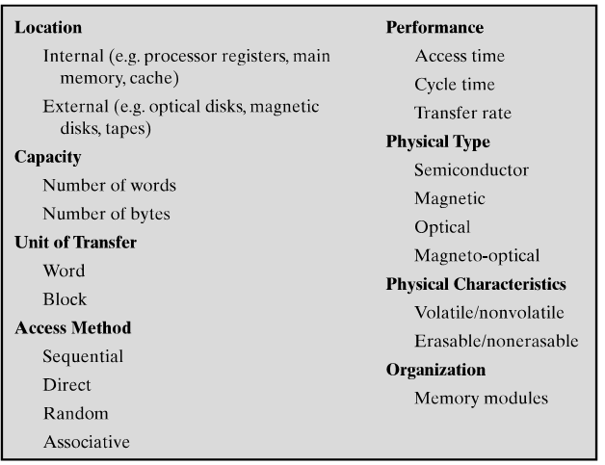
Key Characteristics of Computer Memory Systems

Slide 14
The Basics of Caches
Cache: a safe place for hiding or storing things.
Caches first appeared in research computers in the early 1960s and in production computers later in that same decade
Every general-purpose computer built today, from servers to low-power embedded processors, includes caches

Slide 15
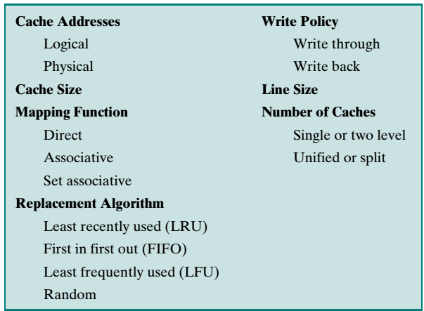

Slide 16
Logical Vs Physical Caches
A logical cache, also known as a virtual cache, stores data using virtual addresses.
A physical cache stores data using main memory physical addresses.

Slide 17
Cache Organization
Main memory consists of up to 2^{n} addressable words, with each word having a unique n-bit address.
For mapping purposes, this memory is considered to consist of a number of fixed-length blocks of K words each.
That is, there are M = 2^{n}/K blocks in main memory.
The cache consists of m blocks, called lines.
In referring to the basic unit of the cache, the term line is used, rather than the term block.
Each line contains K words plus a tag of a few bits. Each line also includes control bits.

Slide 18
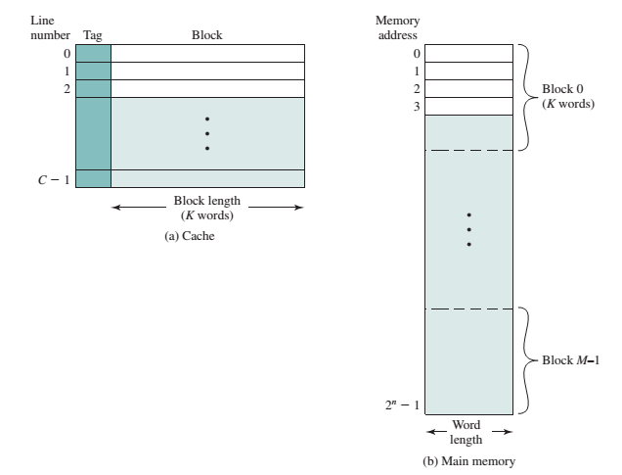

Slide 19
The length of a line, not including tag and control bits, is the line size.
Line size may be as less as 32 bits (a word).
The number of lines is considerably less than the number of main memory blocks (m<<M).
At any time, some subset of the blocks of memory resides in lines in the cache.
Because there are more blocks than lines, an individual line cannot be uniquely and permanently dedicated to a particular block. Thus, each line includes a tag that identifies which particular block is currently being stored.
The tag is usually a portion of the main memory address

Slide 20
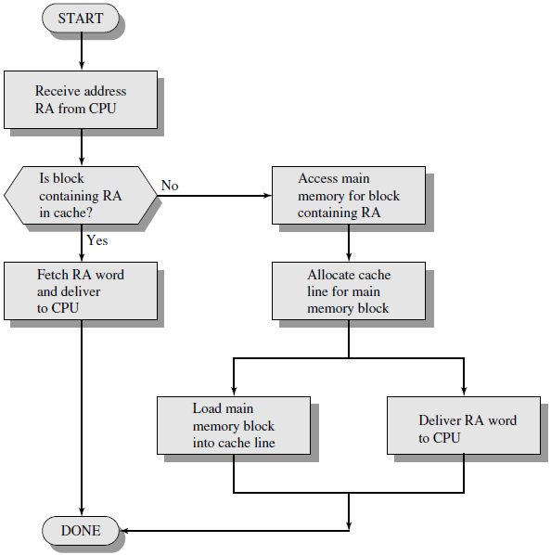
Cache Read operation

Slide 21
Mapping Functions
Cache has fewer lines than main memory blocks. We need
An algorithm for mapping main memory blocks into cache lines.
A method for determining which main memory block currently occupies a cache line (the tags).
The choice of the mapping function dictates how the cache is organized. Three techniques can be used:
Direct Mapping
Associative Mapping
Set associative Mapping

Slide 22
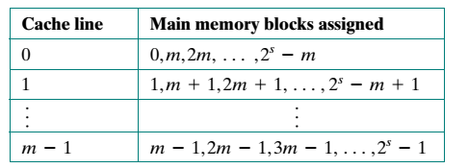
1. Direct Mapping
The simplest technique, known as direct mapping, maps each block of main memory into only one possible cache line.
The mapping is expressed as:
i = j modulo m
Where
i = cache line number
j = main memory block number
m = number of lines in the cache

Slide 23
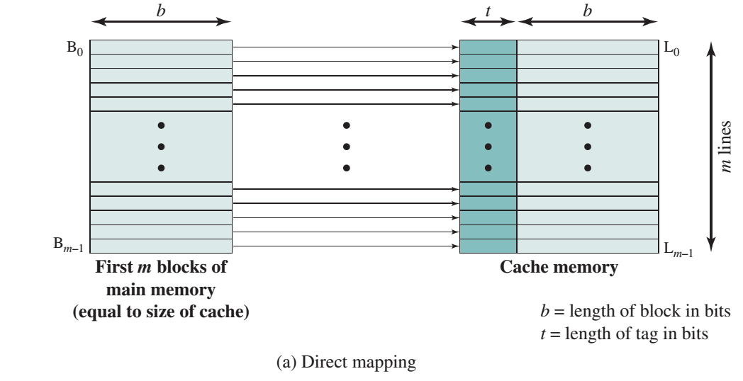
The next blocks of main memory map into the cache in the same fashion; that is, block Bm of main memory maps into line L0 of cache, block B m +1 maps into line L1, and so on.
Notes:
Direct addressing is many to one mapping

Slide 24
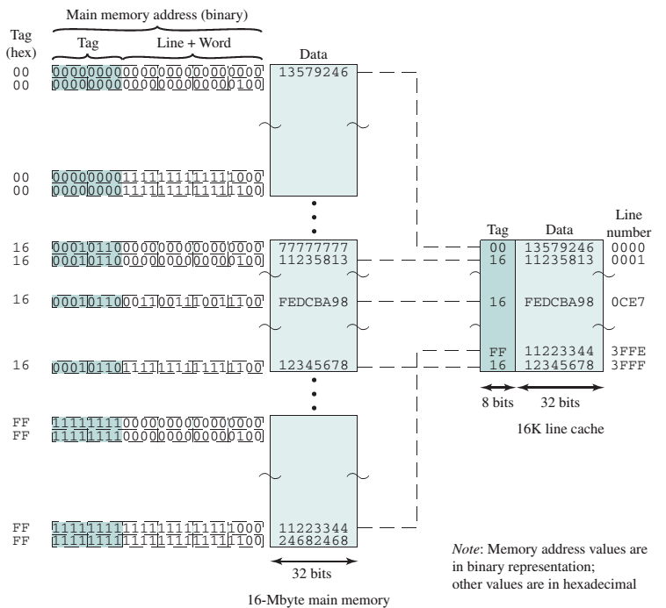

Slide 25
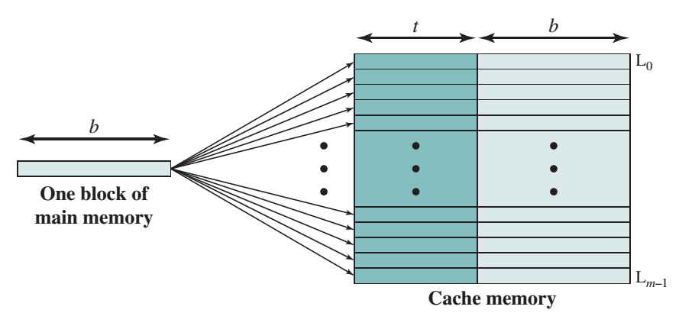
2. Associative Mapping
It maps each main memory block into any line of the cache
Tag is used to identify a specific block of cache

Slide 26
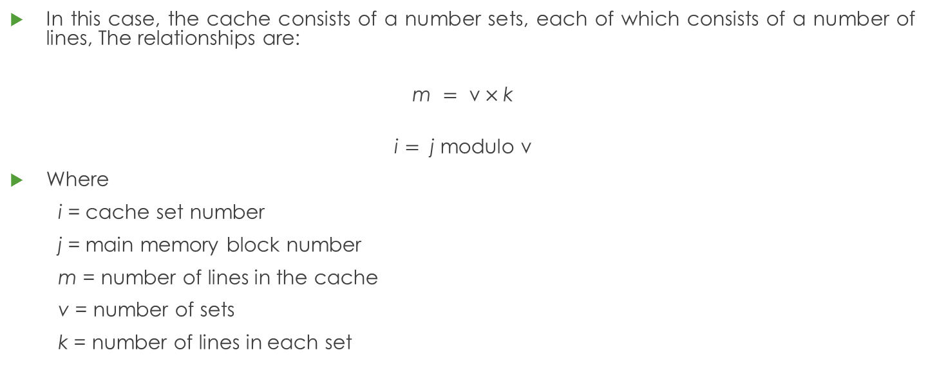
3. Set Associative Mapping
In this case, the cache consists of a number sets, each of which consists of a number of lines, The relationships are:
$$\text{m} = \text{v}×\text{k}$$
$$\text{i} \text{=} \text{j} \text{modulo} \text{v}$$
Where
i = cache set number
j = main memory block number
m = number of lines in the cache
v = number of sets
k = number of lines in each set

Slide 27
3. Set Associative Mapping
This is referred to as k-way set-associative mapping.
With set-associative mapping, block B_{j} can be mapped into any of the lines of set j.
For set-associative mapping, each word maps into all the cache lines in a specific set, so that main memory block B0 maps into set 0, and so on.

Slide 28
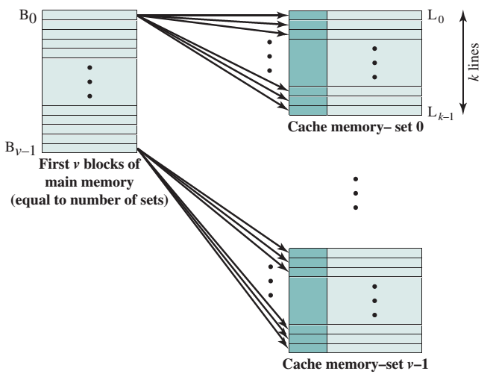

Slide 29
Memory is accessed as words; where word is smallest accessible memory.
Blocks may take multiple words, memory is accessed as blocks.
Size of a line is equal to that of a block:
e.g. On a given system memory size is 64 words (2⁶ : 6 bits long address)
Each block consists of 4 words (2² : 2 bits long addresses); there are 16 blocks on the memory.
a cache of sized 4-lines can contain 4 blocks of memory (2 bits long line numbers) it can take 4 blocks; 16 words may be there in the given cache.
Because there are 4 words in each block the block offsets will be 2 bits long.

Slide 30
CPU generates the address of required memory word, for our example it will be a 6-bit long address.
Taking that address the word is first found in cache, if not found(cache miss), then main memory is searched for the word.
Address Seen by Memory: The address is divided into two parts: the least two bits will be block offset, other 4-bits will be block number.
E.g. 001011 (0010: block number, 11: block offset).

Slide 31
Direct mapping maps the blocks in their respective line numbers, or
line number (i) = block number(j) % total lines in cache (m)

Slide 32
Address (Seen by Cache)
The 4 bits of our block number are further divided into line number (2 bits) and tag (2 bits), e.g the address: 001011
00 | 10 | 11
Tag | Line Number | Block Offset

Slide 33
The Cache (Direct Mapping)
Whether 53 (110101)is there in the cache?
Whether 16 (010000)is there??
Tag | Line | Words
00 | 00 | 00,01,10,11
11 | 01 | 00,01,10,11
10 | 10 | 00,01,10,11
11 | 11 | 00,01,10,11

